Slide 1
Introduction to SimAI
April, 2025
Presented by Florian Jacta – Product Specialist

Slide 2
The Problems
Spending hours/days for simulation
Worried of wrong results
Less time for innovation

Slide 3
A Brief History of Deep Learning
Deep Learning has roots dating back to the 1940s through early neural network research.
Machine Learning breakthroughs over the following decades set the stage for modern Deep Learning.
Accessible computing power now drives a new era of rapid innovation.
Deep Learning is transforming industries worldwide, from healthcare to finance and beyond.
Language
(LLM)
Time Series
(RNN)
Deep Learning
Image
(Stable Diffusion)
Physics
?

Slide 4
Standard DeepLearning models
Going from CFD (Computational Fluid Dynamics) to DeepLearning models
PointNet++
Flexible for data points), but lose relationship between points.
GNN
Capture local relationships and interactions, but slower and hard to scale.
3D CNN
Captures local spatial features, but lose geometry precision.
SimAI
Tailored for CAE needs and overcomes the limitations of other options.
GNN: Graph Neural Network | CNN: Convolutional Neural Network

Slide 5
What is SimAI?
SimAI leverages Deep Learning models to approximate physics simulation results.
Trains on volumetric or surface simulation data through transfer learning.
Outputs pressure, velocity, or similar fields from 3D inputs.
Fast and Reliable
Confidence Level
Secure
Cloud
Physics Support
User Friendly Interface
Notes:
Reduces simulation time from hours to seconds.
Ideal for fast iterations in engineering workflows.
Let you perform optimization.

Slide 6


SimAI
 | SimAI | Normal CAE | Other DL models
Fast Iteration
Automatic optimization
Reliable
User Friendly Interface
In two clicks
No DL knowledge |  | -
Cloud-enabled generative artificial intelligence platform

Slide 7
Use Case: optimize a design to reduce drag

Slide 8
Spoiler Design Optimization
Objective: The user wants to minimize drag by adjusting spoiler shape/position.
CFD is too slow. SimAI gives near-instant predictions, but optimization is still manual.
Optimization strategies:
Manual try and error
Slow
Imprecise
Custom
Grid search
Test all possibilities
Inefficient
Time Consuming
SimAI approaches
It is now quick to run simulations. Using SHAP/Grad-CAM, we can understand why a certain shape performs better.
Bayesian net: build a surrogate model, iteratively test best candidates.
Reinforcement Learning: train an agent to learn best designs.
Genetic Algorithm: inspired from biology; evolve a population of spoiler shapes over time.
Note: gradient based optimization is difficult as geometry is discrete

Slide 9
Bayesian optimization for drag reduction
What is Bayesian Optimization?
A smart, adaptive search algorithm that learns how SimAI responds to spoiler designs and suggests the next best configuration — no gradients required.
It builds a surrogate model: a fast, approximate function that mimics SimAI’s drag predictions and helps decide which designs are worth testing.
Why use it with SimAI?
Balances exploration (trying new ideas) and exploitation (refining promising ones)
Easy to integrate with SimAI’s prediction API
Works with continuous, bounded parameters
Example parameters
spoiler_angle ∈ [5°, 25°]
spoiler_width ∈ [0.8, 1.2]
spoiler_height ∈ [0.05, 0.20]

Slide 10
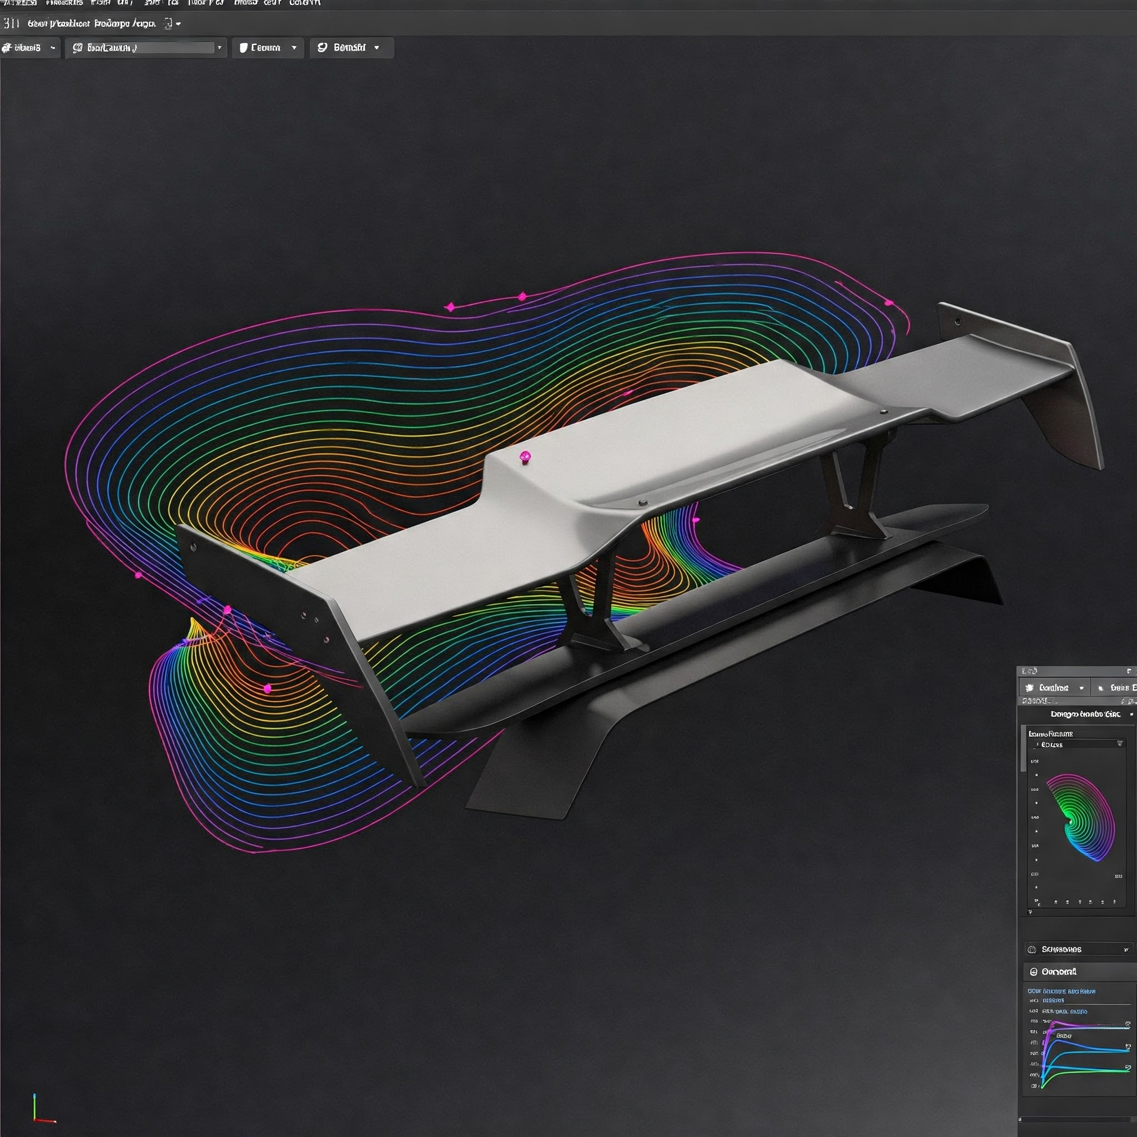
Proposed workflow
The results
Define parameters (e.g., spoiler angle, width, position)
Initial Designs
Run the Model → Predict Drags through PySimAI
Use Bayesian optimizer
(use scikit optimize)
Propose new geometry
Iterate to minimize drag
Predictions are fast to iterate
Suggest better shapes
Reduce drag
Satisfy stress constraints
Explore large design spaces without simulating each design
At the end, drag decreases significantly automatically in a small amount of time.

Slide 11

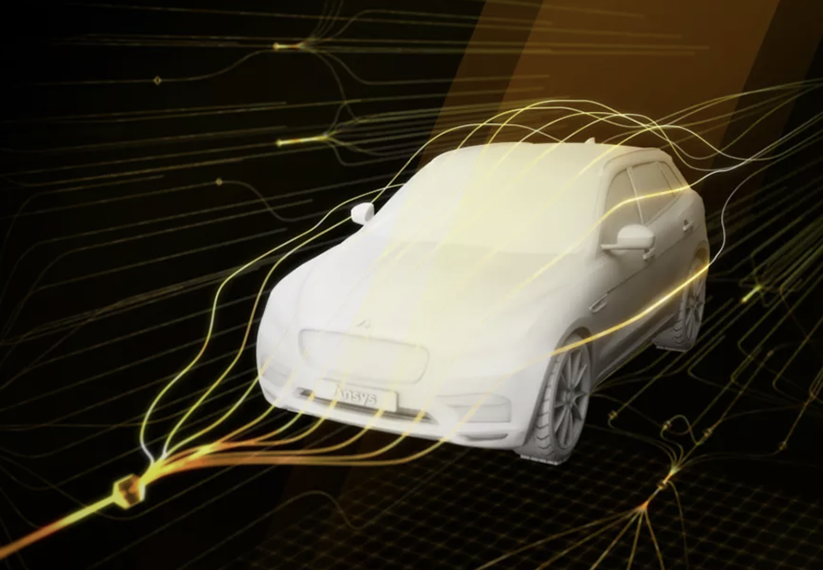

See more on SimAI
Fast and reliable data-driven insights
Intuitive and simple workflow
Flexible deployment options
Expansive design space exploration

